Slide 1

Group seminar
08.05.2020

Slide 2
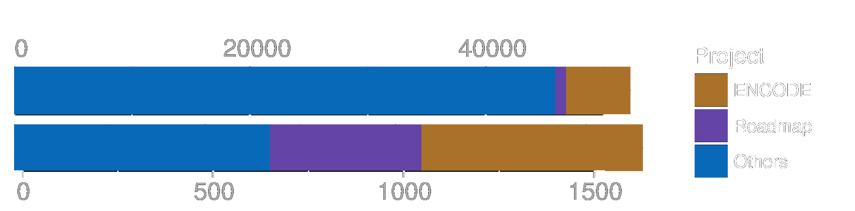
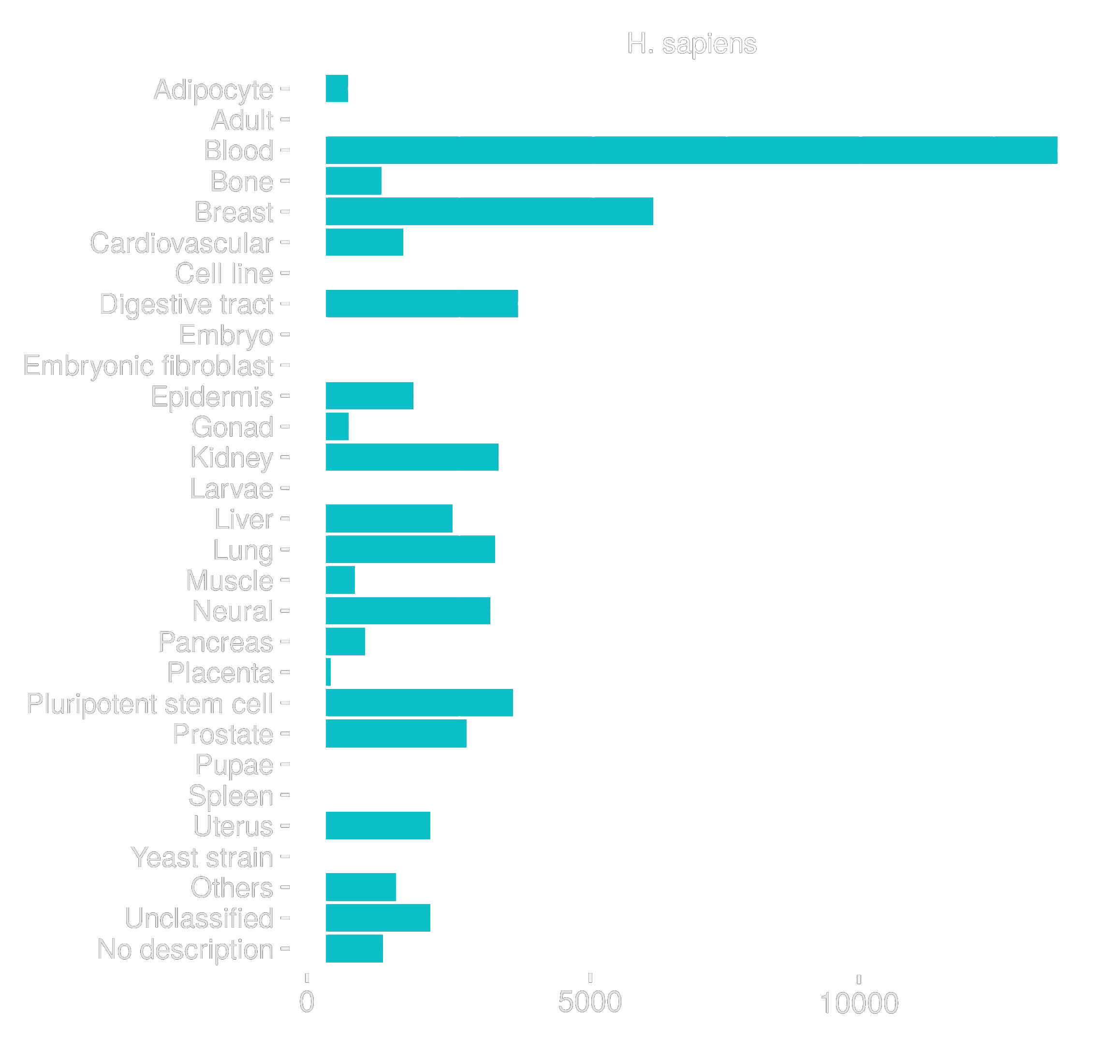
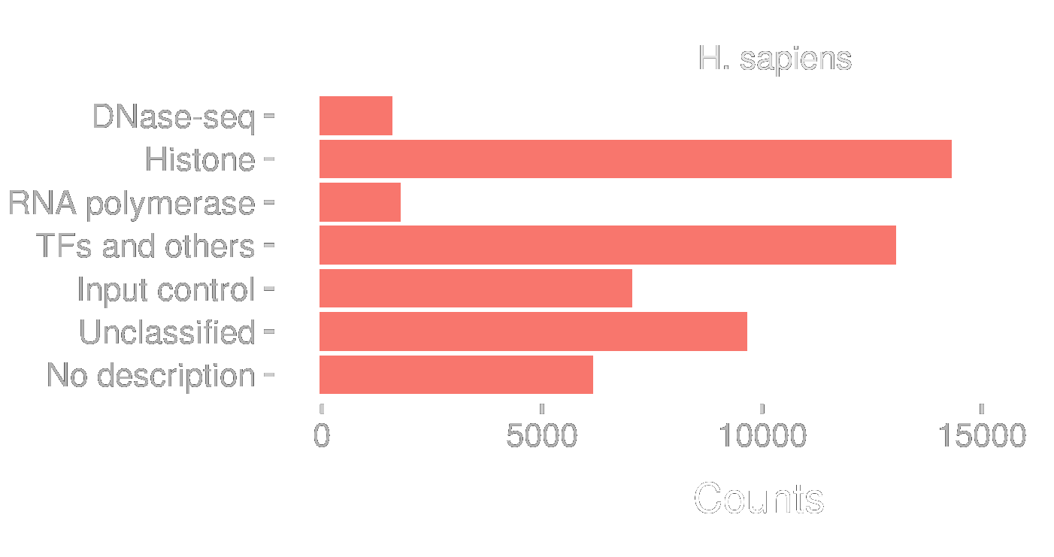
5 4 0 0 0
Single Experiments
1 0 8 3
Different factors
ChIP-Seq
DNAse-Seq
∑ 758.000.000
Single reads in one file
Notes:
-nucleic acid sequences, both DNA and RNA, containing runs of guanines (G-tracts) separated by other bases spontaneously fold into G-quadruplex structures in vitro
-The inherent propensity of guanines to self-associate forming four-stranded helical structures has been known since the early 1960
-G-quadruplexes are G-quartets that are formed through a cyclic Hoogsten hydrogen-bonding arrangement of four guanines with each other. The planar G-quartets stack on top of one another forming four-stranded helical structures. G-quadruplex formation is driven by monovalent cations such as Na⁺ and K⁺, and hence physiological buffer conditions favour their formation
-G-quadruplex structures are topologically very polymorphic and can arise from the intra- or inter- molecular folding of G-rich strands. Intra-molecular folding requires the presence of four or more G-tracts in one strand, whereas inter-molecular folding can arise from two or four strands giving rise to parallel or antiparallel structures depending on the orientation of the strands in a G-quadruplex

Slide 3
track name="EPAS1 (@ All cell types) 50" url="http://chip-atlas.org/view?id=$$" gffTags="on" chr1 9869 10464
ID=SRX968419;Name=EPAS1%20(@%20786-O);Title=GSM1642766:%20ChIP-Seq%20of%20HIF-2a%20in%
20786-O%20with%20HIF-1a%20re-expression%3B%20Homo%20sapiens%3B%20ChIP-Seq;Cell%20group=Kidney;
<br>source_name=Renal%20Cancer%20Cell%20Line;cell%20line=786-O;transfection=HIF-1a%20(pRRL-HIF-1a);
chip%20antibody=HIF-2alpha%20Antibody%20(PM9); 700 . 9869 10464 204,255,0
Experimental ID (SRX, ERX, DRX) | SRX968419
Genome assembly | hg19
Antigen class | TFs
Antigen | EPAS1
Cell type class | Kidney
Cell type | 786-O
Cell type description | Renal Cancer Cell Line
Processing logs (# of reads, % mapped, % duplicates, # of peaks [Q < 1E-05]) | 30180878,82.3,42.1,6691
Title | GSM1642766: ChIP-Seq of HIF-2a in 786-O with HIF-1a re-expression Homo sapiens ChIP-Seq;Cell group=Kidney
Meta data submitted by authors | Renal Cancer Cell Line;cell line=786-O;transfection=HIF-1a (pRRL-HIF-1a);
 | Chip antibody=HIF-2alpha Antibody (PM9); 700 . 9869 10464 204,255,0
track name="EPAS1 (@ All cell types) 50" url="http://chip-atlas.org/view?id=$$" gffTags="on" chr1 9869 10464
ID=SRX968419;Name=EPAS1%20(@%20786-O);Title=GSM1642766:%20ChIP-Seq%20of%20HIF-2a%20in%
20786-O%20with%20HIF-1a%20re-expression%3B%20Homo%20sapiens%3B%20ChIP-Seq;Cell%20group=Kidney;
<br>source_name=Renal%20Cancer%20Cell%20Line;cell%20line=786-O;transfection=HIF-1a%20(pRRL-HIF-1a);
chip%20antibody=HIF-2alpha%20Antibody%20(PM9); 700 . 9869 10464 204,255,0
track name="EPAS1 (@ All cell types) 50" url="http://chip-atlas.org/view?id=$$" gffTags="on" chr1 9869 10464
ID=SRX968419;Name=EPAS1%20(@%20786-O);Title=GSM1642766:%20ChIP-Seq%20of%20HIF-2a%20in%
20786-O%20with%20HIF-1a%20re-expression%3B%20Homo%20sapiens%3B%20ChIP-Seq;Cell%20group=Kidney;
<br>source_name=Renal%20Cancer%20Cell%20Line;cell%20line=786-O;transfection=HIF-1a%20(pRRL-HIF-1a);
chip%20antibody=HIF-2alpha%20Antibody%20(PM9); 700 . 9869 10464 204,255,0

Slide 4
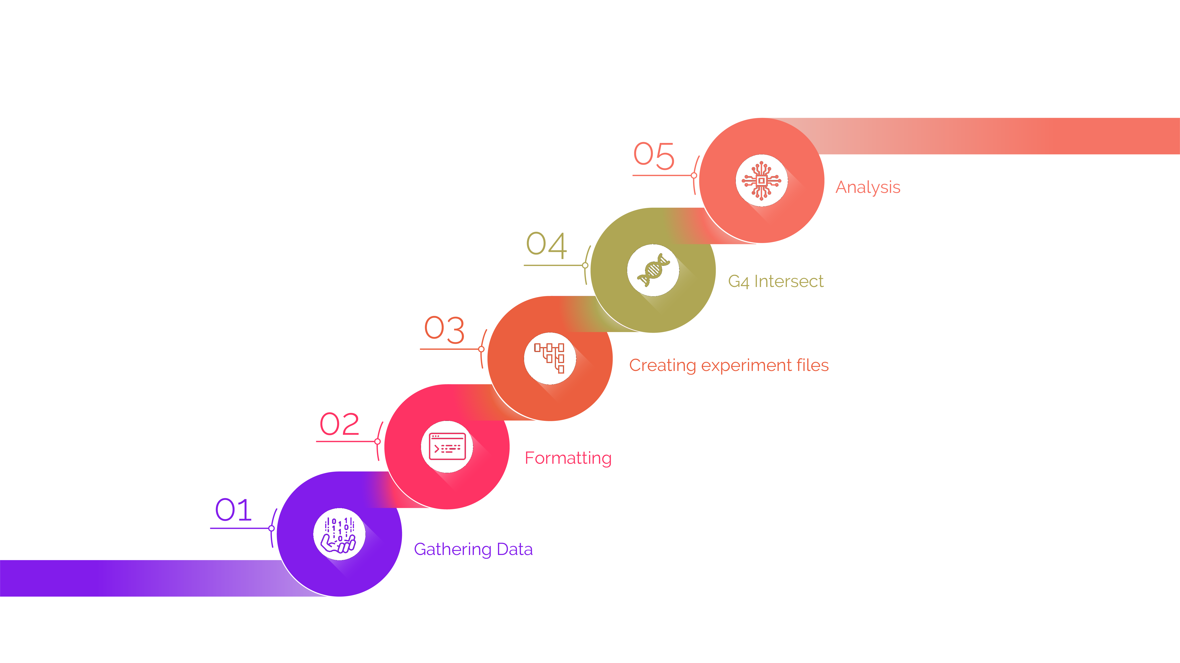
ChIP-Seq
Notes:
-nucleic acid sequences, both DNA and RNA, containing runs of guanines (G-tracts) separated by other bases spontaneously fold into G-quadruplex structures in vitro
-The inherent propensity of guanines to self-associate forming four-stranded helical structures has been known since the early 1960
-G-quadruplexes are G-quartets that are formed through a cyclic Hoogsten hydrogen-bonding arrangement of four guanines with each other. The planar G-quartets stack on top of one another forming four-stranded helical structures. G-quadruplex formation is driven by monovalent cations such as Na⁺ and K⁺, and hence physiological buffer conditions favour their formation
-G-quadruplex structures are topologically very polymorphic and can arise from the intra- or inter- molecular folding of G-rich strands. Intra-molecular folding requires the presence of four or more G-tracts in one strand, whereas inter-molecular folding can arise from two or four strands giving rise to parallel or antiparallel structures depending on the orientation of the strands in a G-quadruplex

Slide 5
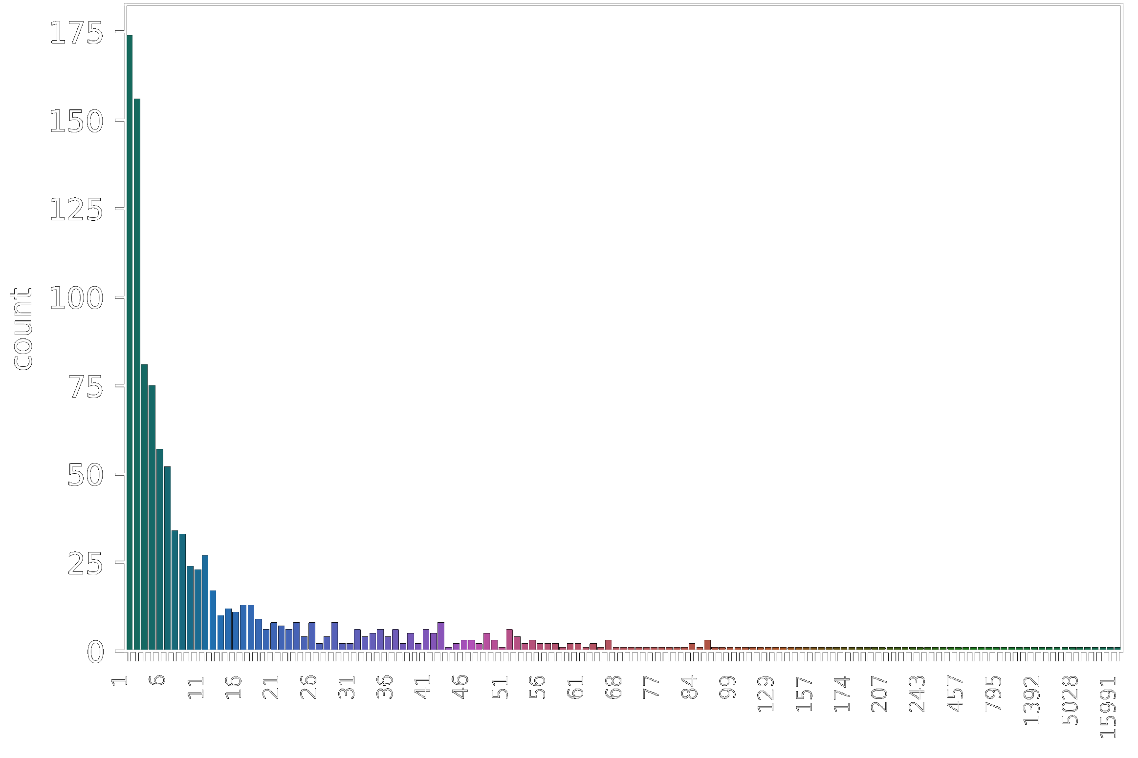
# of experiments per target
ChIP-Seq
DNAse-Seq
Notes:
-nucleic acid sequences, both DNA and RNA, containing runs of guanines (G-tracts) separated by other bases spontaneously fold into G-quadruplex structures in vitro
-The inherent propensity of guanines to self-associate forming four-stranded helical structures has been known since the early 1960
-G-quadruplexes are G-quartets that are formed through a cyclic Hoogsten hydrogen-bonding arrangement of four guanines with each other. The planar G-quartets stack on top of one another forming four-stranded helical structures. G-quadruplex formation is driven by monovalent cations such as Na⁺ and K⁺, and hence physiological buffer conditions favour their formation
-G-quadruplex structures are topologically very polymorphic and can arise from the intra- or inter- molecular folding of G-rich strands. Intra-molecular folding requires the presence of four or more G-tracts in one strand, whereas inter-molecular folding can arise from two or four strands giving rise to parallel or antiparallel structures depending on the orientation of the strands in a G-quadruplex

Slide 6
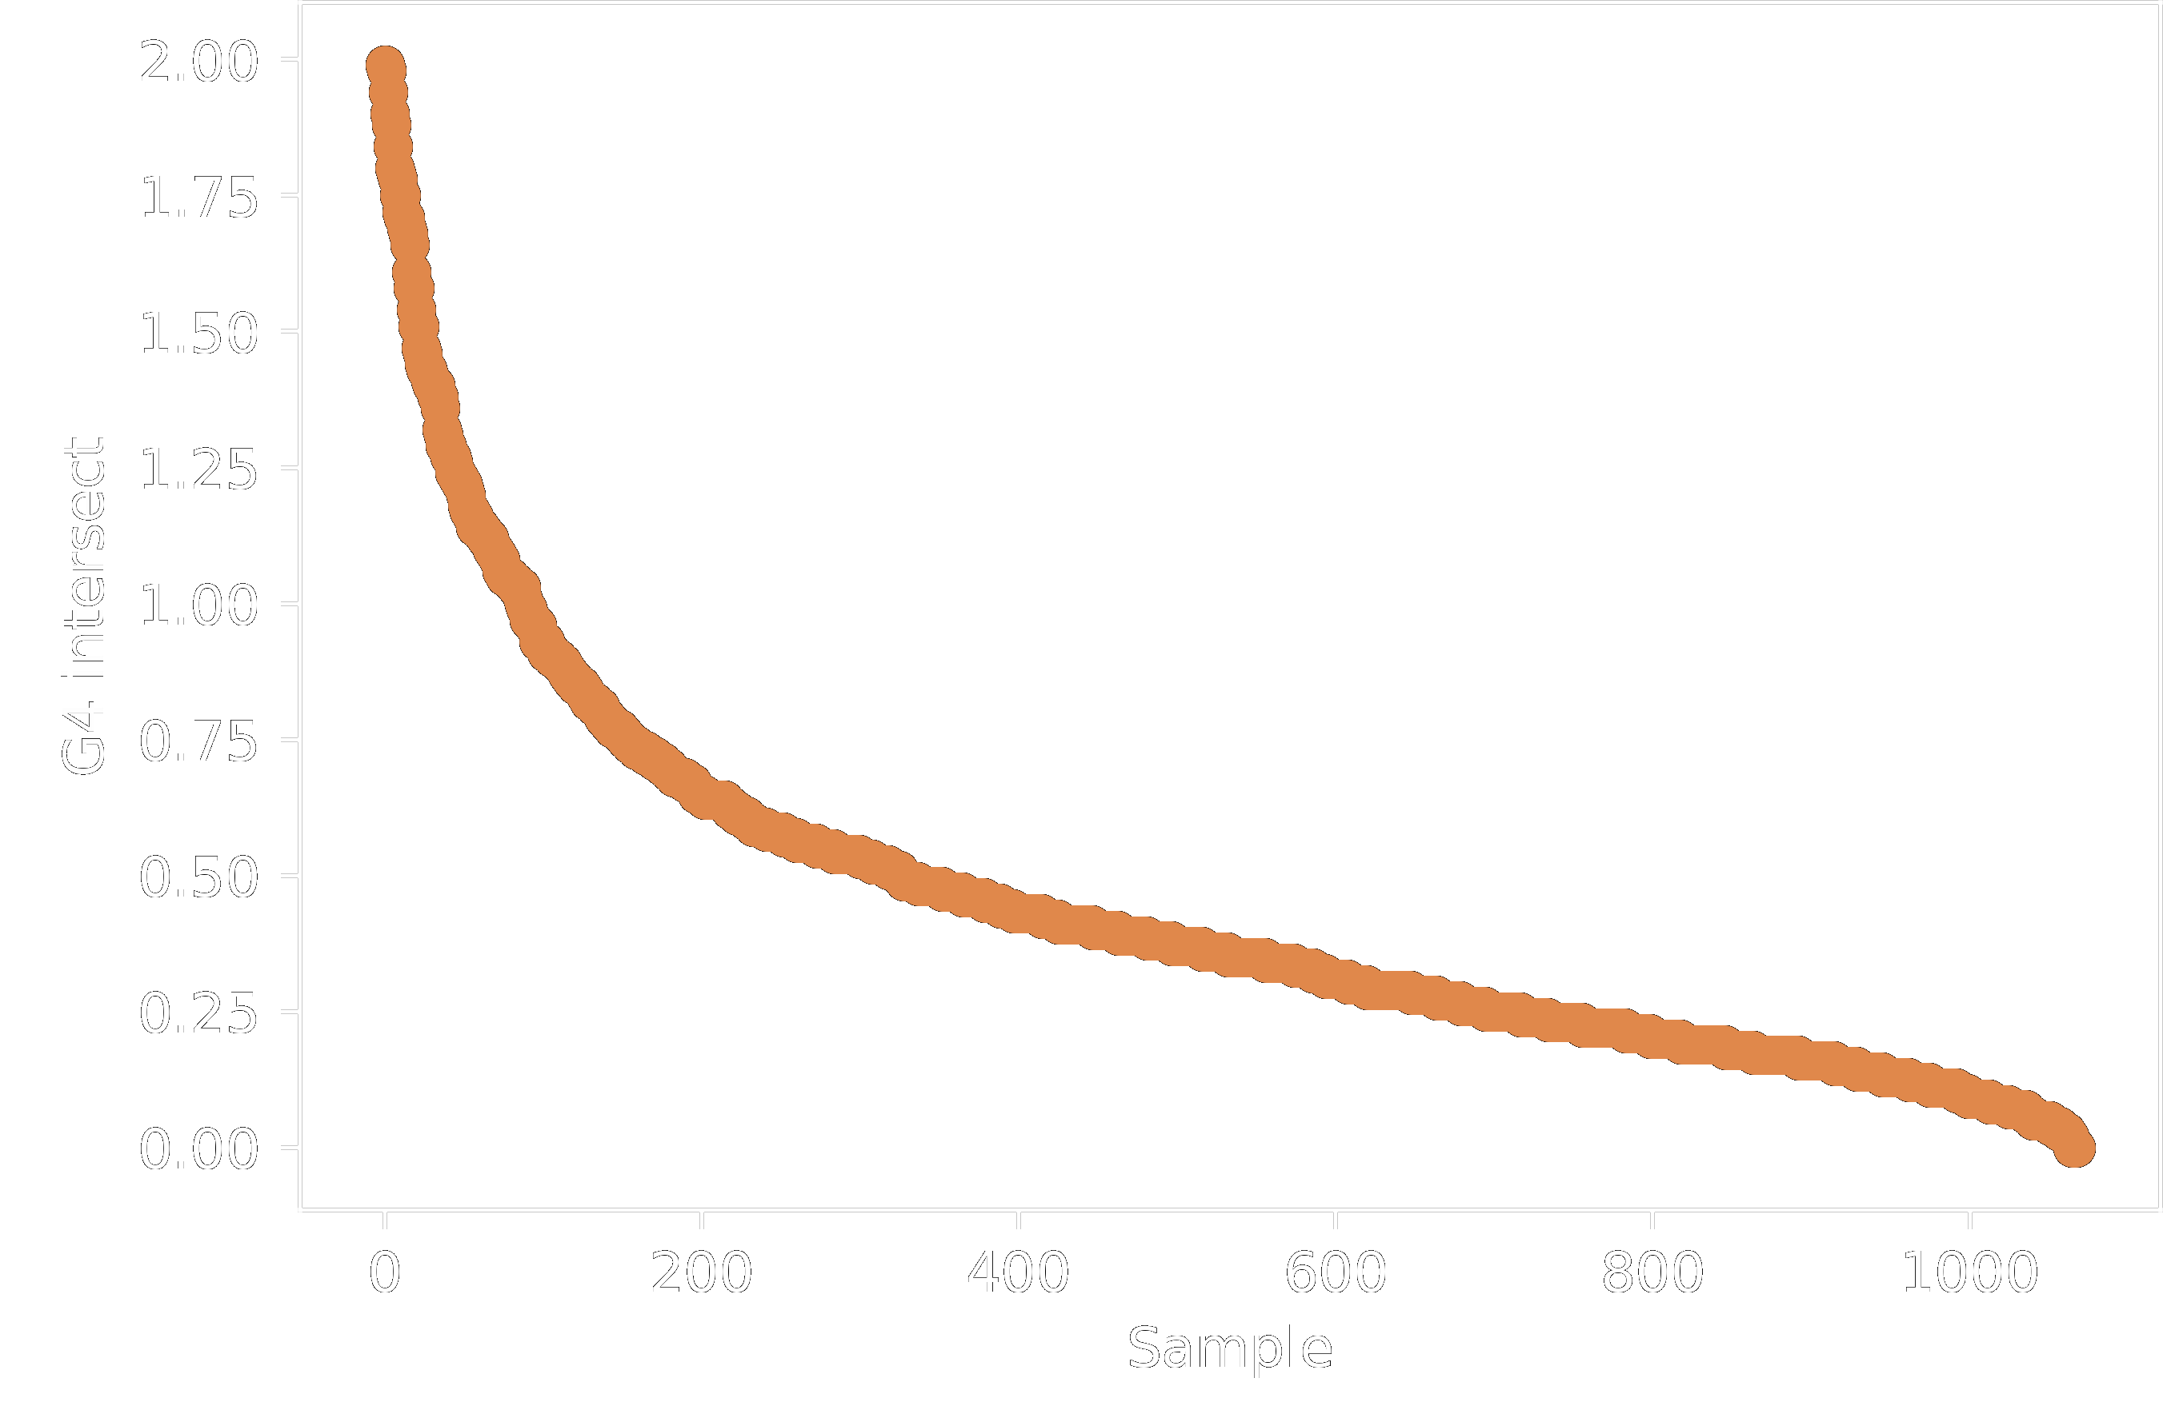
Spread of G4-factors
ChIP-Seq
DNAse-Seq
Notes:
-nucleic acid sequences, both DNA and RNA, containing runs of guanines (G-tracts) separated by other bases spontaneously fold into G-quadruplex structures in vitro
-The inherent propensity of guanines to self-associate forming four-stranded helical structures has been known since the early 1960
-G-quadruplexes are G-quartets that are formed through a cyclic Hoogsten hydrogen-bonding arrangement of four guanines with each other. The planar G-quartets stack on top of one another forming four-stranded helical structures. G-quadruplex formation is driven by monovalent cations such as Na⁺ and K⁺, and hence physiological buffer conditions favour their formation
-G-quadruplex structures are topologically very polymorphic and can arise from the intra- or inter- molecular folding of G-rich strands. Intra-molecular folding requires the presence of four or more G-tracts in one strand, whereas inter-molecular folding can arise from two or four strands giving rise to parallel or antiparallel structures depending on the orientation of the strands in a G-quadruplex

Slide 7
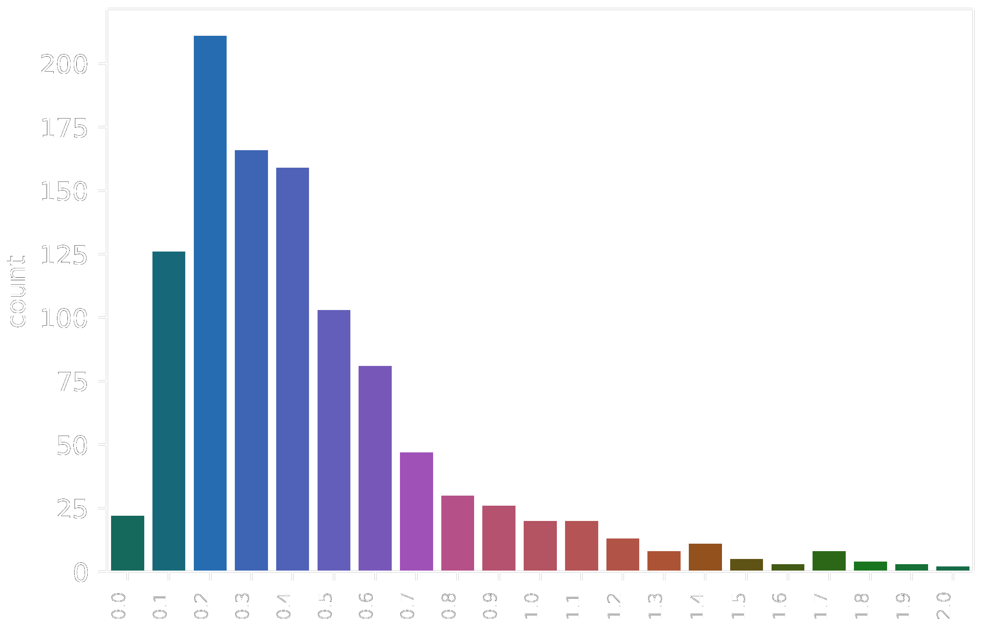
Frequency of G4-factors
ChIP-Seq
DNAse-Seq
Notes:
-nucleic acid sequences, both DNA and RNA, containing runs of guanines (G-tracts) separated by other bases spontaneously fold into G-quadruplex structures in vitro
-The inherent propensity of guanines to self-associate forming four-stranded helical structures has been known since the early 1960
-G-quadruplexes are G-quartets that are formed through a cyclic Hoogsten hydrogen-bonding arrangement of four guanines with each other. The planar G-quartets stack on top of one another forming four-stranded helical structures. G-quadruplex formation is driven by monovalent cations such as Na⁺ and K⁺, and hence physiological buffer conditions favour their formation
-G-quadruplex structures are topologically very polymorphic and can arise from the intra- or inter- molecular folding of G-rich strands. Intra-molecular folding requires the presence of four or more G-tracts in one strand, whereas inter-molecular folding can arise from two or four strands giving rise to parallel or antiparallel structures depending on the orientation of the strands in a G-quadruplex

Slide 8
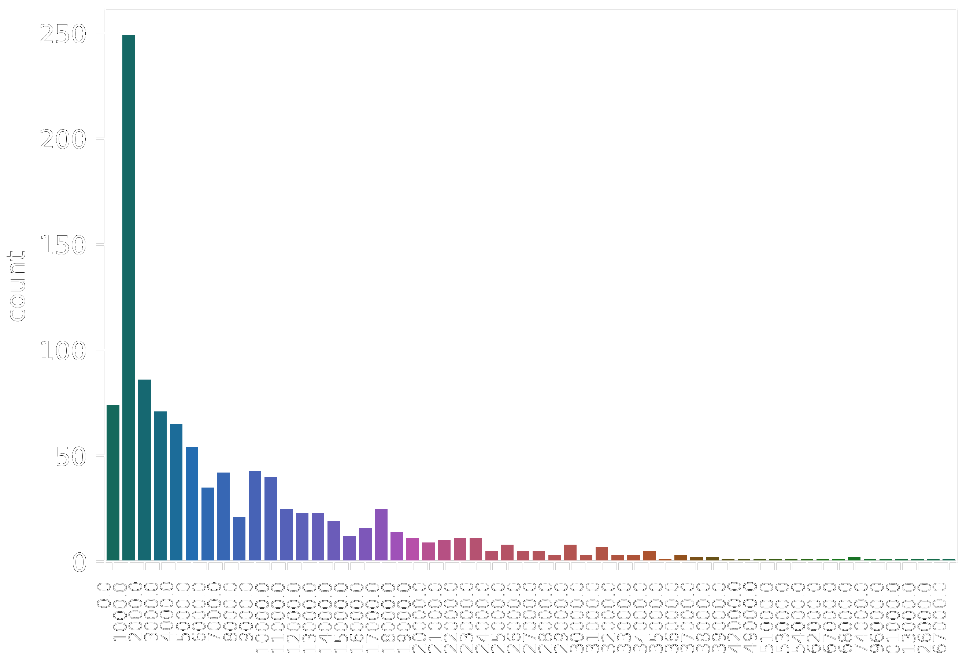
# of reads per experiment
ChIP-Seq
DNAse-Seq
Notes:
-nucleic acid sequences, both DNA and RNA, containing runs of guanines (G-tracts) separated by other bases spontaneously fold into G-quadruplex structures in vitro
-The inherent propensity of guanines to self-associate forming four-stranded helical structures has been known since the early 1960
-G-quadruplexes are G-quartets that are formed through a cyclic Hoogsten hydrogen-bonding arrangement of four guanines with each other. The planar G-quartets stack on top of one another forming four-stranded helical structures. G-quadruplex formation is driven by monovalent cations such as Na⁺ and K⁺, and hence physiological buffer conditions favour their formation
-G-quadruplex structures are topologically very polymorphic and can arise from the intra- or inter- molecular folding of G-rich strands. Intra-molecular folding requires the presence of four or more G-tracts in one strand, whereas inter-molecular folding can arise from two or four strands giving rise to parallel or antiparallel structures depending on the orientation of the strands in a G-quadruplex

Slide 9
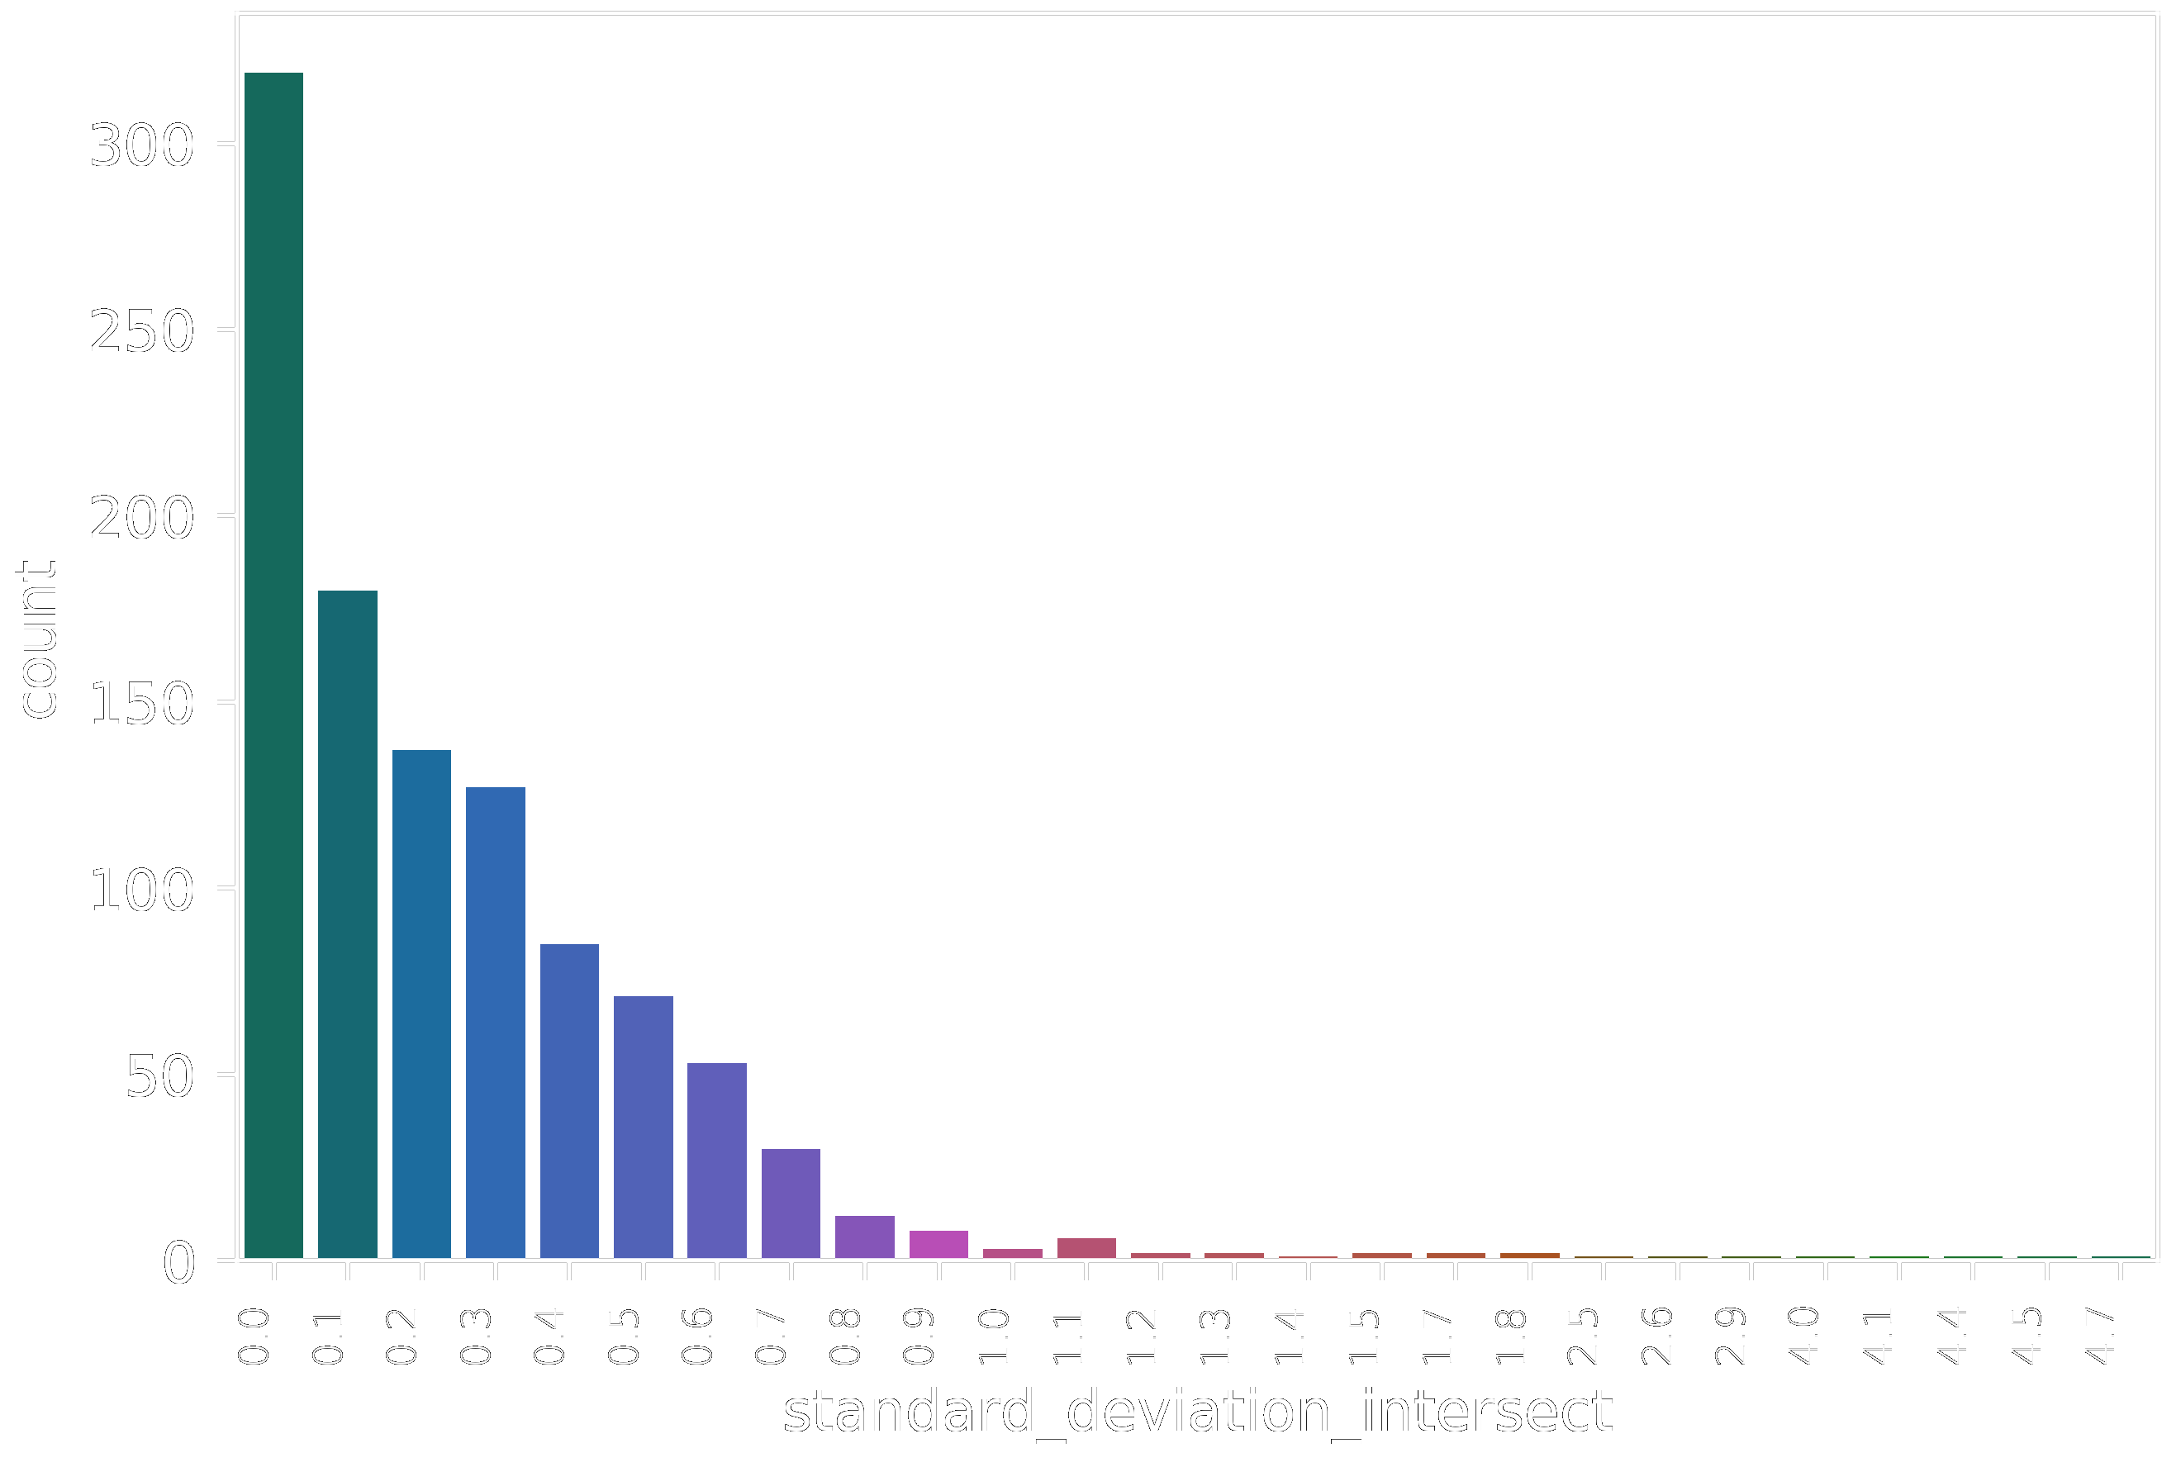
Spread of standard deviation
ChIP-Seq
DNAse-Seq
Notes:
-nucleic acid sequences, both DNA and RNA, containing runs of guanines (G-tracts) separated by other bases spontaneously fold into G-quadruplex structures in vitro
-The inherent propensity of guanines to self-associate forming four-stranded helical structures has been known since the early 1960
-G-quadruplexes are G-quartets that are formed through a cyclic Hoogsten hydrogen-bonding arrangement of four guanines with each other. The planar G-quartets stack on top of one another forming four-stranded helical structures. G-quadruplex formation is driven by monovalent cations such as Na⁺ and K⁺, and hence physiological buffer conditions favour their formation
-G-quadruplex structures are topologically very polymorphic and can arise from the intra- or inter- molecular folding of G-rich strands. Intra-molecular folding requires the presence of four or more G-tracts in one strand, whereas inter-molecular folding can arise from two or four strands giving rise to parallel or antiparallel structures depending on the orientation of the strands in a G-quadruplex

Slide 10
Protein G4_score Std_dvtn mean_read_sz #_of_exp
H3K4me3 | 1.269348025 | 0.752989 | 20988.34641 | 3366
H3K9K14K18K23K27ac | 1.124632388 | 0.245499 | 5216 | 4
H3K18cr | 1.056286855 | 0.572251 | 5893.75 | 8
H3K9ac | 1.00812281 | 0.633546 | 16554.55438 | 377
H3K5ac | 0.903340237 | 0.0649982 | 30668.5 | 2
H3K9K14ac | 0.873655432 | 0.683112 | 18319.21154 | 52
H3K18ac | 0.861092215 | 0.5555 | 17075.0375 | 80
H3K27ac | 0.836834112 | 0.497248 | 25042.38783 | 5028
H3K14me3 | 0.766649523 | 0.171144 | 693 | 2
H3K56ac | 0.74219639 | 0.635622 | 21574.04545 | 22
H3K79me3 | 0.725360527 | 0.547923 | 4383.088889 | 45
H3K4me2 | 0.722182869 | 0.552554 | 33549.63386 | 508
H3K79me2 | 0.653259811 | 0.437228 | 5646.230453 | 243
H3K27me1 | 0.64898679 | 1.67088 | 1709.733333 | 15
H3K36ac | 0.604651187 | 0.352526 | 16712 | 10
H3K79me1 | 0.549686608 | 0.630365 | 1985.869565 | 23
H3K4ac | 0.543381694 | 0.39713 | 9406.413793 | 29
H3K122ac | 0.541445716 | 0.386762 | 32506.14286 | 14
H3K27me3 | 0.539914499 | 0.599832 | 4550.401515 | 2112
H3K23ac | 0.465644354 | 0.522113 | 3262.076923 | 39
H3K14ac | 0.403228606 | 0.339248 | 8166.138889 | 36
H3K4me1 | 0.395910367 | 0.429292 | 26972.16258 | 1550
H3K27me2 | 0.390933748 | 0.321535 | 558.2857143 | 14
H3K36me3 | 0.341503537 | 0.340551 | 3709.887658 | 632
H3K4ox | 0.333182328 | 0.00843688 | 33634 | 2
H3K9me3 | 0.251245735 | 0.285419 | 6533.683019 | 795
H3K9me1 | 0.247645299 | 0.23198 | 826.44 | 25
H3K9me2 | 0.231778755 | 0.181277 | 1973.162791 | 172
H3K36me2 | 0.225507717 | 0.31051 | 2200.046154 | 65
H3K79suc | 0.087254151 | 0.0711672 | 2049.5 | 2
H3K36me1 | 0.072519581 | 0.0281355 | 848.4285714 | 7
H3K9K14K18K23K27ac | 1.124632388 | 0.245499 | 5216 | 4
H3K9ac | 1.00812281 | 0.633546 | 16554.55438 | 377
H3K5ac | 0.903340237 | 0.0649982 | 30668.5 | 2
H3K9K14ac | 0.873655432 | 0.683112 | 18319.21154 | 52
H3K18ac | 0.861092215 | 0.5555 | 17075.0375 | 80
H3K27ac | 0.836834112 | 0.497248 | 25042.38783 | 5028
H3K56ac | 0.74219639 | 0.635622 | 21574.04545 | 22
H3K36ac | 0.604651187 | 0.352526 | 16712 | 10
H3K4ac | 0.543381694 | 0.39713 | 9406.413793 | 29
H3K122ac | 0.541445716 | 0.386762 | 32506.14286 | 14
H3K23ac | 0.465644354 | 0.522113 | 3262.076923 | 39
H3K14ac | 0.403228606 | 0.339248 | 8166.138889 | 36
ac
ChIP-Seq
H3K4me3 | 1.269348025 | 0.752989 | 20988.34641 | 3366
H3K14me3 | 0.766649523 | 0.171144 | 693 | 2
H3K79me3 | 0.725360527 | 0.547923 | 4383.088889 | 45
H3K4me2 | 0.722182869 | 0.552554 | 33549.63386 | 508
H3K79me2 | 0.653259811 | 0.437228 | 5646.230453 | 243
H3K27me1 | 0.64898679 | 1.67088 | 1709.733333 | 15
H3K79me1 | 0.549686608 | 0.630365 | 1985.869565 | 23
H3K27me3 | 0.539914499 | 0.599832 | 4550.401515 | 2112
H3K4me1 | 0.395910367 | 0.429292 | 26972.16258 | 1550
H3K27me2 | 0.390933748 | 0.321535 | 558.2857143 | 14
H3K36me3 | 0.341503537 | 0.340551 | 3709.887658 | 632
H3K9me3 | 0.251245735 | 0.285419 | 6533.683019 | 795
H3K9me1 | 0.247645299 | 0.23198 | 826.44 | 25
H3K9me2 | 0.231778755 | 0.181277 | 1973.162791 | 172
H3K36me2 | 0.225507717 | 0.31051 | 2200.046154 | 65
H3K36me1 | 0.072519581 | 0.0281355 | 848.4285714 | 7
DNAse-Seq
me
Notes:
-nucleic acid sequences, both DNA and RNA, containing runs of guanines (G-tracts) separated by other bases spontaneously fold into G-quadruplex structures in vitro
-The inherent propensity of guanines to self-associate forming four-stranded helical structures has been known since the early 1960
-G-quadruplexes are G-quartets that are formed through a cyclic Hoogsten hydrogen-bonding arrangement of four guanines with each other. The planar G-quartets stack on top of one another forming four-stranded helical structures. G-quadruplex formation is driven by monovalent cations such as Na⁺ and K⁺, and hence physiological buffer conditions favour their formation
-G-quadruplex structures are topologically very polymorphic and can arise from the intra- or inter- molecular folding of G-rich strands. Intra-molecular folding requires the presence of four or more G-tracts in one strand, whereas inter-molecular folding can arise from two or four strands giving rise to parallel or antiparallel structures depending on the orientation of the strands in a G-quadruplex

Slide 11
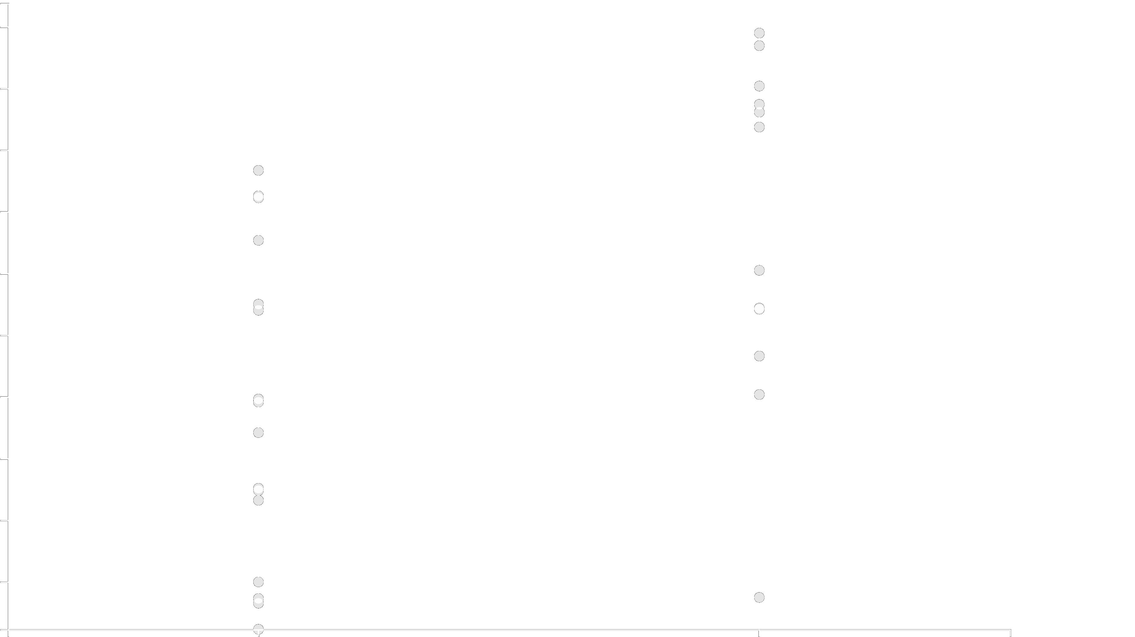
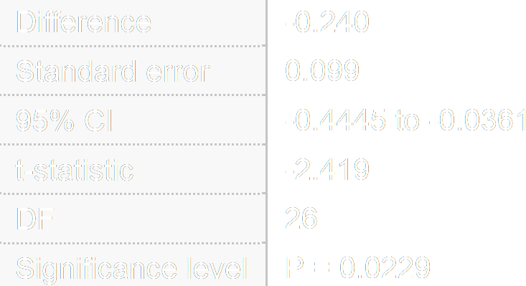
*
1.0
G4-score
ChIP-Seq
0.5
DNAse-Seq
me
ac
Notes:
-nucleic acid sequences, both DNA and RNA, containing runs of guanines (G-tracts) separated by other bases spontaneously fold into G-quadruplex structures in vitro
-The inherent propensity of guanines to self-associate forming four-stranded helical structures has been known since the early 1960
-G-quadruplexes are G-quartets that are formed through a cyclic Hoogsten hydrogen-bonding arrangement of four guanines with each other. The planar G-quartets stack on top of one another forming four-stranded helical structures. G-quadruplex formation is driven by monovalent cations such as Na⁺ and K⁺, and hence physiological buffer conditions favour their formation
-G-quadruplex structures are topologically very polymorphic and can arise from the intra- or inter- molecular folding of G-rich strands. Intra-molecular folding requires the presence of four or more G-tracts in one strand, whereas inter-molecular folding can arise from two or four strands giving rise to parallel or antiparallel structures depending on the orientation of the strands in a G-quadruplex

